Slide 1


Restaurants in Hamilton,ON. IBM Capstone assignment

Slide 2
INTRODUCTION BUSINESS PROBLEM
In this project, I will be using foursquare location data API to locate restaurant locations and categories and utilize k-means clustering to analyze what ethnicity of restaurants exist around where I will be studying in my hometown of Hamilton,ON. I have created beacons on my final plotted map to indicate where the post-secondary educations are in Hamilton, and the restaurant clusters that exist around these institutions. This ‘business problem’ is really my own self project and meant for my own educational (and feeding) purposes. Perhaps once I see what types of restaurants exist around these post-secondary schools will influence where I go to study in the future.

Slide 3
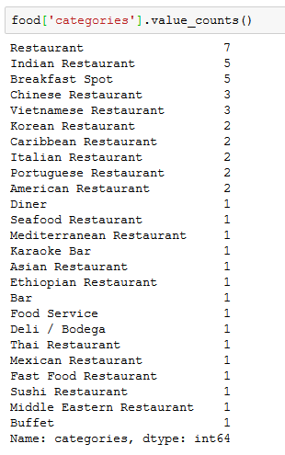
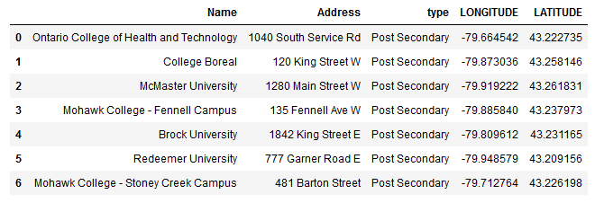
THE DATA
The first set of data consists of the listing of post-secondary education locations and names in Hamilton Ontario, Canada. I parsed the data from a larger dataset found on the ‘open data’ Hamilton website (link found below).
The second dataset is the list of restaurants and the categories they fall in found using the Foresquare API.
https://developer.foursquare.com/
http://open.hamilton.ca/datasets/cccae6f029334927856da6e20a50561f_19

Slide 4

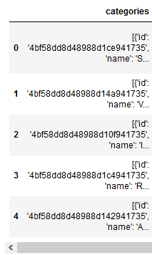
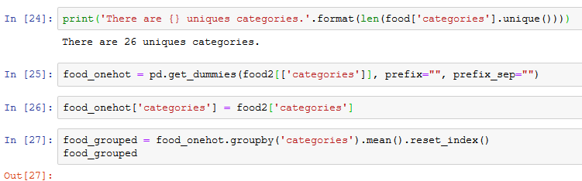
METHODOLOGY & EDA
First, the data was cleaned and ‘grouped’ because it was initially not worthy for analysis such as the example of the ‘categories’ as seen in the image here for example.
Secondly, the datasets had to be parsed because they were much too large and had a lot of data that I did not require. I parsed the restaurant categories down for further analysis by using the ‘get dummies’ method as seen in the image below.
Finally, the K-means clustering is used to perform the clustering of restaurants. My intention was to create as many clusters of as many ‘categories’ of restaurants existed in my dataset which was around 24 categories. The map itself tells the rest of the story and is up for critique as well as interpretation.

Slide 5
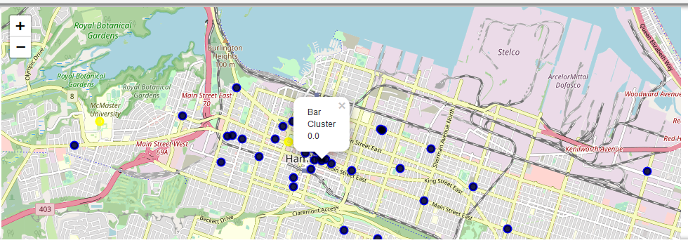
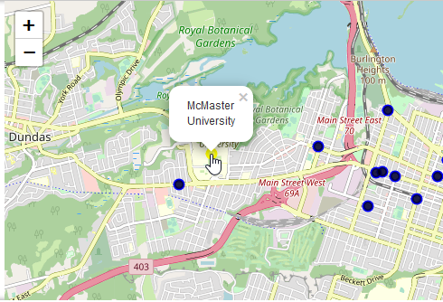
RESULTS
The result of this project was the map that was created at the end. The yellow points on the map indicate a post-secondary institution, which when clicked will tell you the name of the institution. The blue points indicate restaurant category clusters. As you can see here there is some accuracy as we see a cluster of bars close to the downtown post-secondary institution as an example.
I was happy when I saw that the code and the map worked because I can continue to build on this project in the future.

Slide 6
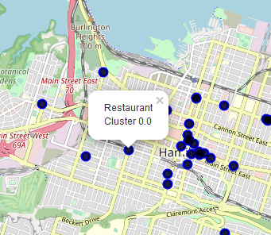
DISCUSSION
As a beginner to Python as well as using packages such as folium this project was a success in the sense that I gained a great deal of knowledge and experience from it such as executing the final code and map. I also got a sense of which ethnic restaurants I would like to now discover in my neighbourhood.
Yet, upon close examination of my results there are certainly problems that need to be ironed out such as some clusters may simply say ‘Restaurant cluster’ which doesn’t tell me anything. Of course, there is always room for improvement.

Slide 7
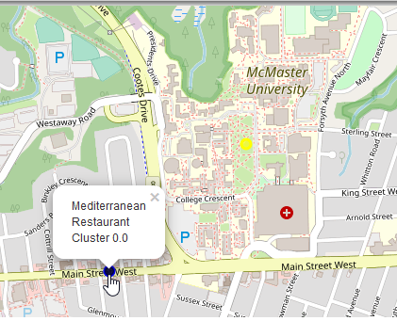
CONCLUSION
In conclusion, I am happy with the resulting map and I intend to continue to build upon it and improve it. I would like to go back and work out its problems although there are some problems that I ran into that I do not know how to fix (which is frustrating; but I am eager to learn) such as the example in the image you see here. I know that close to McMaster University there certainly are Mediterranean restaurants, but there are many many more restaurants in that area as well that do not show up on my map. I cannot figure out why that might be. What could I fix in my code? Perhaps Forsquare needs to be updated? What are some ways I can tighten up my code for future map processing?
Anyways, I thank you for reading this and any feedback is appreciated.
Thank you!

